Slide 1
Assignment 1
Model Answers

Slide 2
Question 1
Q1) Consider building a garden shed project, which involves designing the shed, figuring out what materials are needed, ordering or purchasing the materials, and putting together the various parts. Some of these tasks depend on the others, some must be scheduled
  a. develop a table showing each task, preceding events and expected duration.
  b. Draw the Gantt chart of the activities using any CASE tool.

Slide 3
The answer of Question 1 (a)
Tasks | Preceding events | Expected Duration
1. Design the shed | - | 1 day
2. Preparing Materials | 1 | 8 days
2.1. Develop Materials List | 1 | 1 day
2.2. Order Materials | 1 | 1 day
2.3. Deliver Materials | 2.1 , 2.2 | 7 days
3. Constructing shed parts | 2.3 | 6 days
3.1. Pour Foundation | 2.3 | 1 day
3.2. Build frame | 3.1 | 2 days
3.3. Install roof | 3.2 | 2 days
3.4. Install siding | 3.2 | 1 day
3.5. Finishing | 3.3 | 1 day

Slide 4
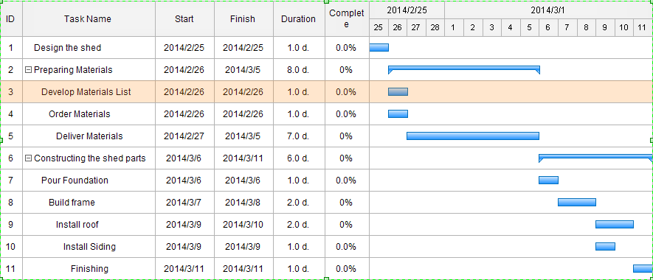
The answer of Question 1 (b)
Gantt Chart: (using EDRAW MAX Software)

Slide 5
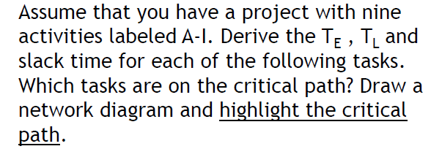
Question 2

Slide 6
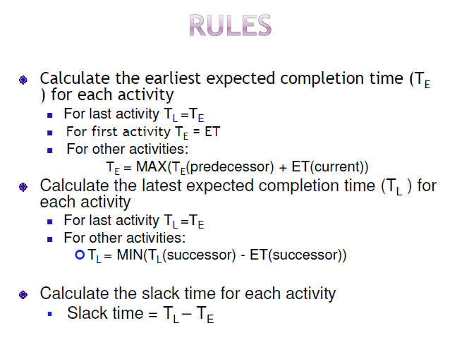
The answer of Question 2

Slide 7
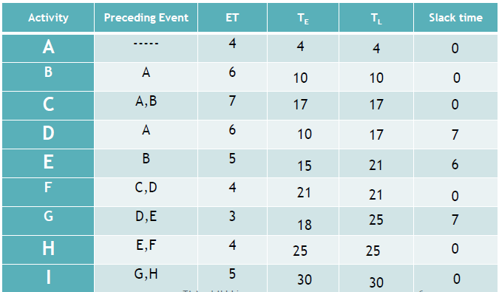
The answer of Question 2 [cont.]

Slide 8
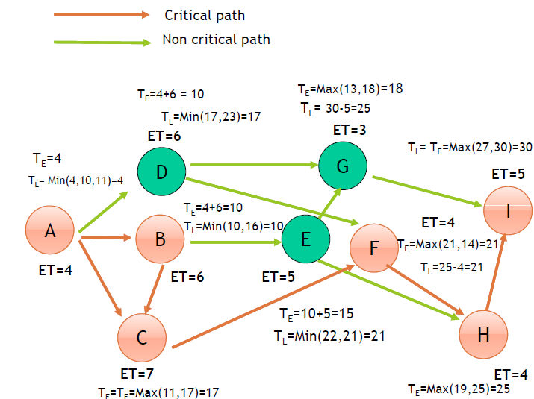
The answer of Question 2 [cont.]

